Slide 1
Spring Boot Essentials: From Auto-Configuration to Actuator

Slide 2
Introduction to Auto-Configuration
Auto-Configuration is a Spring Boot feature that automatically configures beans and dependencies based on what it finds in the classpath, application context, and environment properties.
Auto-Configuration is a Spring Boot mechanism that automatically configures application components (beans) based on the:
Dependencies available on the classpath
Beans already defined in the application context
Configuration properties provided by the developer
This reduces the need for manual XML/Java configuration and allows applications to run with sensible defaults.

Slide 3
Importance of Auto Configration
Saves Time & Effort
You don’t need to write long configuration files
Spring Boot sets up most things automatically.
Reduces Errors
Fewer manual settings mean fewer chances of mistakes in setup.
Quick Project Start
Just add the required dependency (like web or JPA), and you get a ready-to-use setup instantly.
Sensible Defaults
Comes with pre-set defaults (like port 8080, JSON handling, database config) that work out of the box.
Flexible & Customizable
If you want to override, you can provide your own bean or set values in application.properties.
Keeps Code Clean
Removes unnecessary boilerplate configuration and makes the codebase easier to read and maintain.

Slide 4
Examples of Auto-Configuration
Real-Life Examples of Auto-Configuration
Web Applications (Adding spring-boot-starter-web)
Auto-configures DispatcherServlet, Jackson, MessageConverters, Embedded Tomcat/Jetty.
You can start a REST API without writing servlet config.
Data Applications (Adding spring-boot-starter-data-jpa)
Auto-configures DataSource, EntityManagerFactory, JpaTransactionManager.
Default database: H2 (in-memory) if nothing else provided.
Messaging (Adding spring-boot-starter-amqp (RabbitMQ))
Auto-configures ConnectionFactory, RabbitTemplate, and required infrastructure beans.
Similarly for Kafka with spring-kafka.
Security (Adding spring-boot-starter-security)
Auto-configures login form, password encoder, and default security filter chain.
Default user → user with a generated password (printed in logs).

Slide 5
Working of Auto-Configuration
Application Startup
When you run a Spring Boot app, it starts with the SpringApplication class.
This creates the Application Context (the container that holds all beans).
Auto-Configuration Turned On️
The @SpringBootApplication annotation automatically includes @EnableAutoConfiguration.
This tells Spring Boot to “Check what dependencies are available, and configure them automatically.”
Spring Factories File
Spring Boot looks into a special file: META-INF/spring.factories.
This file has a list of all auto-configuration classes (like DataSourceAutoConfiguration, WebMvcAutoConfiguration).
Conditional Checks
Before applying a configuration, Spring Boot checks conditions:
@ConditionalOnClass → Does a certain class exist? (e.g., DataSource)
@ConditionalOnMissingBean → Has the developer already defined this bean?
@ConditionalOnProperty → Is a property set in application.properties?
Bean Registration
If conditions match → Spring Boot creates and registers the bean automatically.
If you already defined your own bean → Auto-Config steps back (does not override).
Application Ready
After all auto-config classes are checked and beans are registered, the Application Context is ready.
Now your app can serve requests immediately without manual setup.

Slide 6
Spring Annotations – Introduction
Annotations are small pieces of metadata you add to Java code (classes, methods, fields, parameters) that tell a framework — like Spring — how to treat that piece of code.
Instead of external XML, annotations let you declare behavior inline, and Spring reads them at runtime to wire everything together.
Java annotations have retention policies (SOURCE, CLASS, RUNTIME). Spring needs annotations with RUNTIME retention so it can read them at runtime.
Annotations that annotate other annotations (e.g., @Transactional is processed specially; @GetMapping is a meta-annotation on @RequestMapping).

Slide 7
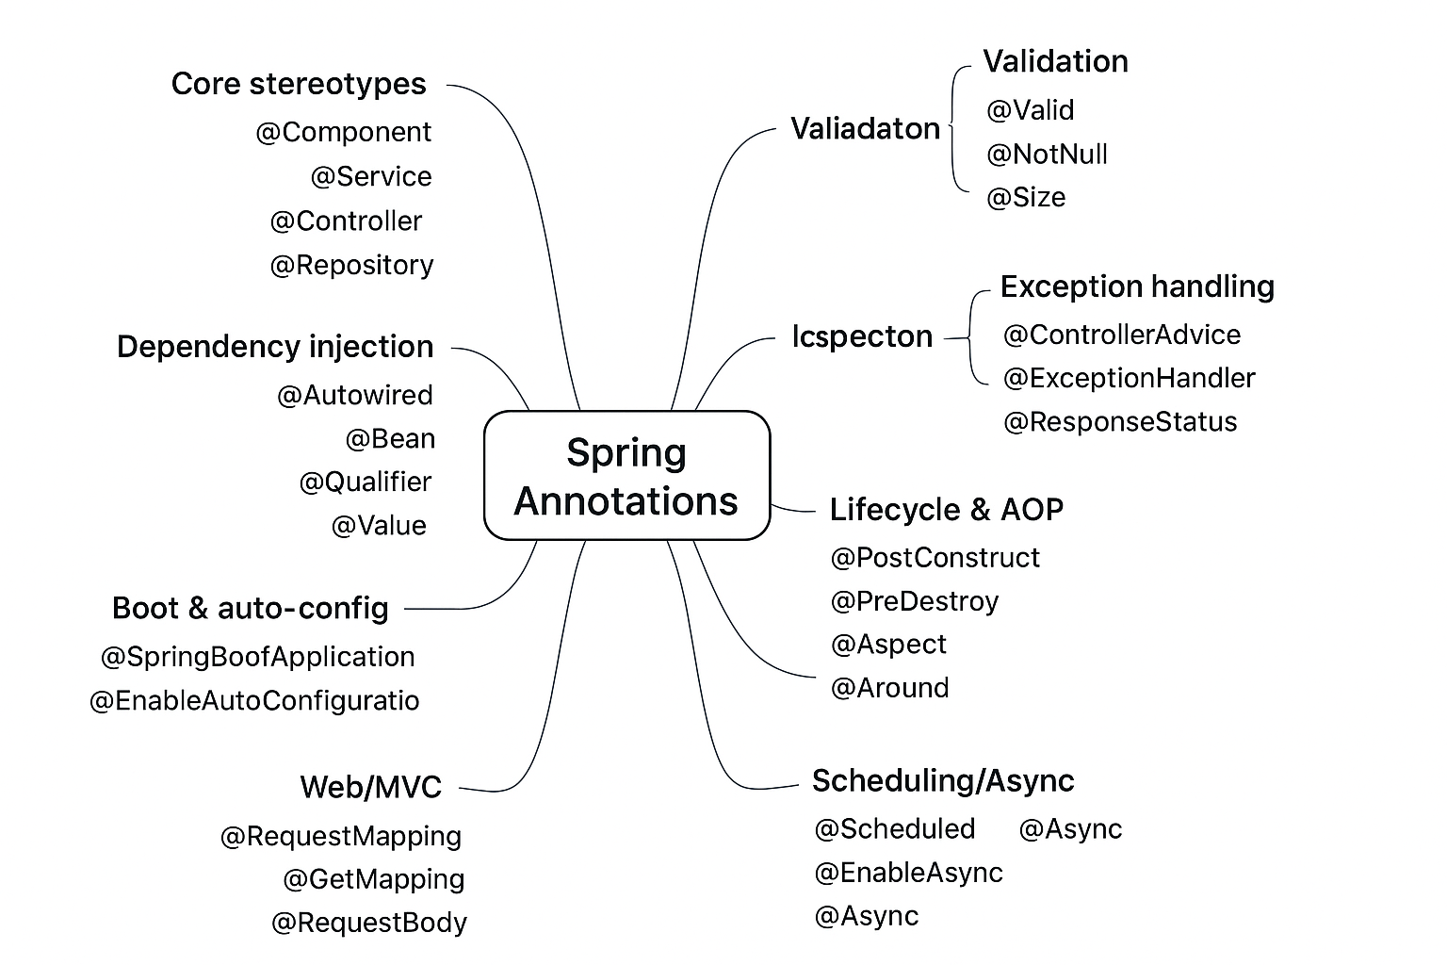
Categories of Spring Annotations
Spring annotations can be grouped into these categories.
Core stereotype annotations
Dependency injection & bean management
Boot & auto-configuration
Web/MVC
Data/JPA
Validation
Exception handling
Lifecycle & AOP
Scheduling & Async
Security & Caching

Slide 8
Core Stereotype Annotations
These tell Spring what kind of component a class is, so that Spring can detect and manage it as a bean.
@Component → A generic stereotype annotation used to mark a class as a Spring bean. It is the base for all specialized stereotypes (@Service, @Controller, @Repository). Used for utility or helper classes that don’t belong to a specific layer.
@Controller → Marks a class as a Spring MVC controller. It handles incoming web requests and typically returns a view (like HTML via Thymeleaf/JSP). Best suited for traditional MVC web applications.
@RestController → A shorthand for @Controller + @ResponseBody. It is mainly used for building REST APIs where methods return JSON or XML data directly to the client instead of a view.
@Service → Used to mark classes that hold business logic. It makes the code more readable, signals intent, and is often used with @Transactional to manage transactions in the service layer.
@Repository → Indicates DAO (Data Access Object) classes that directly interact with the database. It not only marks the bean but also enables Spring to translate persistence exceptions into a consistent DataAccessException hierarchy.

Slide 9
Dependency Injection Annotations
These annotations help in injecting dependencies and managing bean creation.
@Autowired → Automatically injects a bean by type. Spring resolves the dependency and populates the field, constructor, or setter.
@Qualifier("beanName") → Used with @Autowired to specify which bean to inject when multiple candidates of the same type exist.
@Inject → Standard Java dependency injection annotation, similar to @Autowired. Works with Spring for type-based injection.
@Value("${property}") → Injects values from application.properties or application.yml into fields or method parameters.
@Configuration → Marks a class as a source of bean definitions. Spring processes it to generate beans at runtime.
@Bean → Declares a method that returns a Spring-managed bean. Used inside @Configuration classes.
@Lazy → Defers bean initialization until it is first needed, rather than at application startup.
@Primary → Marks a bean as the default candidate when multiple beans of the same type exist.
@Scope("prototype"/"singleton") → Defines bean lifecycle: singleton (one shared instance) or prototype (new instance per injection).

Slide 10
Spring Boot & Auto-Configuration Annotations
Marks the main class of a Spring Boot application and enables auto-configuration, component scanning, and configuration.
@SpringBootApplication → Marks the main class of a Spring Boot app. Combines @Configuration, @EnableAutoConfiguration, and @ComponentScan. Enables auto-configuration and component scanning in one annotation.
@EnableAutoConfiguration → Tells Spring Boot to automatically configure beans based on classpath and property settings. Reduces manual configuration by creating default beans when possible.
@ComponentScan → Instructs Spring which packages to scan for components like @Controller, @Service, and @Repository. Ensures Spring detects and registers all beans automatically.
@ConditionalOnClass → Creates a bean only if the specified class is present on the classpath. Helps make auto-configuration conditional on dependencies.
@ConditionalOnMissingBean → Creates a bean only if no other bean of the same type is already defined. Ensures default beans don’t override custom beans.
@ConditionalOnProperty → Creates a bean only if a specific property is set or has a particular value in application.properties or application.yml. Allows configuration-driven conditional beans.

Slide 11
Web & MVC Annotations
Handle web requests, routing, and data binding.
@Controller → Marks a class as a Spring MVC controller. Handles HTTP requests and returns view names.
@RestController → Combines @Controller and @ResponseBody. Returns JSON/XML directly instead of a view.
@RequestMapping → Maps HTTP requests to controller methods. Can specify URL path, method, headers, and params.
@GetMapping / @PostMapping / @PutMapping / @DeleteMapping → Shortcut annotations for @RequestMapping with specific HTTP methods (GET, POST, PUT, DELETE).
@PathVariable → Binds dynamic values from URL path segments to method parameters.
@RequestParam → Binds query parameters or form data to method parameters.
@RequestBody → Binds the HTTP request body (usually JSON/XML) to a Java object.
@ResponseBody → Sends return value of a method directly in HTTP response (JSON/XML).
@ExceptionHandler → Handles exceptions thrown in a controller, allowing custom error responses.
@ControllerAdvice → Global exception handling across multiple controllers. Can also provide global data binding.
@ModelAttribute → Binds method parameters or adds attributes to the model for views.
@SessionAttributes → Stores model attributes in HTTP session across multiple requests.

Slide 12
Data Access / JPA Annotations
Used with Spring Data and JPA for persistence.
@Entity → Marks a class as a JPA entity mapped to a database table. Required for ORM persistence.
@Table → Specifies the database table name and schema for an entity. Optional if the table name matches the class.
@Id → Marks a field as the primary key of the entity. Required for entity identification.
@GeneratedValue → Configures how the primary key value is generated (AUTO, IDENTITY, SEQUENCE, TABLE).
@Column → Maps a field to a table column. Can specify name, length, nullable, and unique constraints.
@OneToOne / @OneToMany / @ManyToOne / @ManyToMany → Defines relationships between entities, including cardinality and fetch type.
@JoinColumn → Specifies the foreign key column for entity relationships.
@Repository → Marks a DAO or repository class and enables exception translation to Spring’s DataAccessException.
@Transactional → Declares that methods or classes should execute within a database transaction.
@Embeddable / @Embedded → Allows embedding value-type objects within entities for reusable component mapping.

Slide 13
Validation & Binding Annotations
Validate and sanitize input using Bean Validation.
@Valid → Triggers validation on an object (DTO, form, or entity) using JSR-303/JSR-380 annotations.
@Validated → Spring-specific variant of @Valid that supports validation groups for more fine-grained control.
@NotNull / @NotEmpty / @NotBlank → Standard bean validation annotations to enforce non-null or non-empty values.
@Size(min=, max=) → Validates the length of a String, Collection, Map, or array within specified bounds.
@Min / @Max → Validates numeric values against minimum or maximum limits.
@Email → Validates that a string conforms to a standard email format.
@Pattern(regexp=) → Validates that a string matches a specified regular expression.
@InitBinder → Customizes data binding for web request parameters, e.g., date formatting or trimming strings.
@ModelAttribute → Binds request parameters to method arguments or adds attributes to the model for views.
@BindingResult → Holds validation errors when using @Valid or @Validated, allowing error handling in controllers.

Slide 14
Exception Handling & Cross-Cutting Annotations
Centralized error handling and cross-cutting logic.
@ExceptionHandler → Handles exceptions thrown within a controller. Allows defining custom responses for specific exception types.
@ControllerAdvice → Provides global exception handling across multiple controllers. Can also define global data binding and model attributes.
@ResponseStatus → Assigns a specific HTTP status code to a response or exception. Useful for returning meaningful status codes.
@RestControllerAdvice → Combines @ControllerAdvice and @ResponseBody. Handles exceptions globally and returns JSON/XML responses.
@Aspect → Marks a class as an aspect in Spring AOP. Used to define cross-cutting concerns like logging, transactions, or security.
@Before / @After / @Around / @AfterReturning / @AfterThrowing → Define advice that executes before, after, or around method executions in aspects.
@Pointcut → Defines a reusable pointcut expression to specify join points for advice in an aspect.

Slide 15
Lifecycle flow + AOP flow,
Manages the creation, initialization, and destruction of beans, while also allowing cross-cutting concerns like logging or transactions to be applied declaratively via aspects.
@PostConstruct → Marks a method to be executed after bean initialization. Used to perform any setup or initialization logic.
@PreDestroy → Marks a method to be executed before bean destruction. Used to release resources or cleanup tasks.
@Autowired → Injects dependencies automatically by type into a bean. Can be applied on fields, constructors, or methods.
@Value("${property}") → Injects property values from application.properties or application.yml into a bean.
@Aspect → Marks a class as an aspect containing cross-cutting concerns like logging, security, or transactions.
@Before → Defines advice that runs before the execution of a matched method.
@After → Defines advice that runs after the execution of a matched method, regardless of outcome.
@AfterReturning → Runs advice only after a method successfully returns.
@AfterThrowing → Runs advice only if a method throws an exception.
@Around → Defines advice that runs before and after a method execution, allowing custom behavior and controlling method execution.
@Pointcut → Defines a reusable expression specifying join points where advice should be applied.

Slide 16
Scheduling & Async Annotations
For background tasks and async processing.
Scheduling Annotations
@EnableScheduling → Enables Spring’s scheduling support.
@Scheduled → Marks a method to run automatically at a fixed rate, fixed delay, or cron expression.
Async Annotations
@EnableAsync → Enables Spring’s asynchronous method execution.
@Async → Marks a method to execute in a separate thread, optionally returning Future or CompletableFuture.

Slide 17
Security & Caching Annotations
Spring Security Annotations
@EnableWebSecurity → Enables Spring Security configuration.
@PreAuthorize → Checks authorization before method execution using an expression.
@PostAuthorize → Checks authorization after method execution based on return value.
@Secured → Restricts access to a method for specific roles.
@RolesAllowed → Java-standard annotation for role-based method access.
Spring Caching Annotations
@EnableCaching → Enables Spring’s caching support.
@Cacheable → Caches the result of a method to avoid repeated computation.
@CachePut → Updates the cache while still executing the method.
@CacheEvict → Removes one or more entries from the cache.

Slide 18
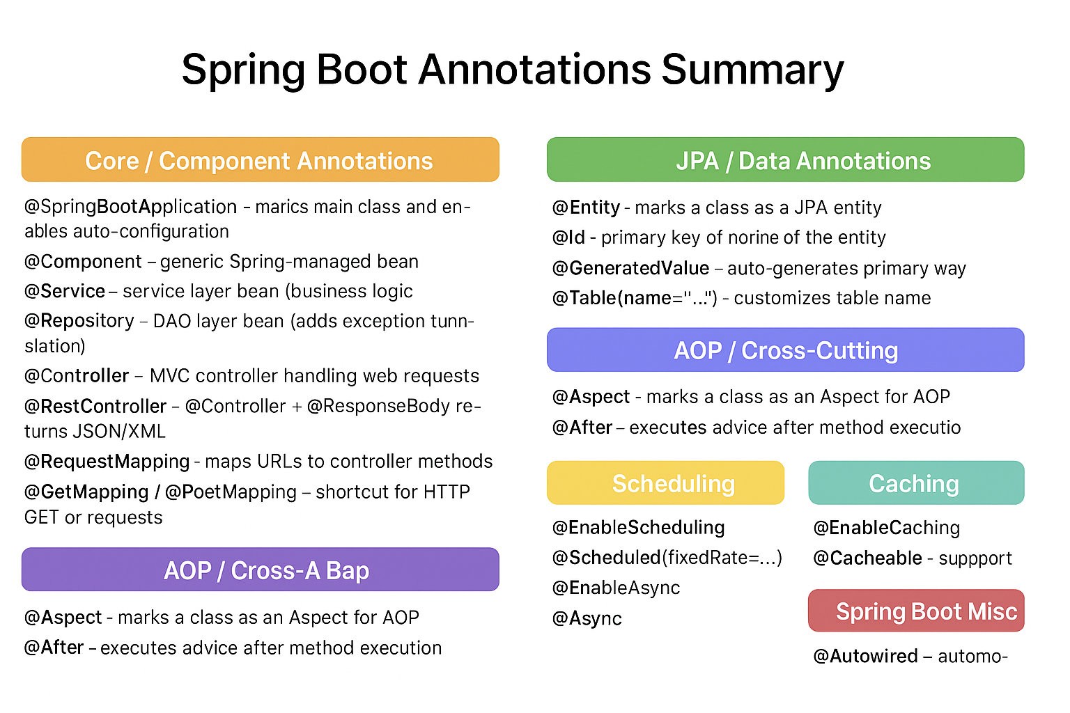

Slide 19
What are Spring Boot Starters?
What are Starters?
Why do we need Starters?
Starters are pre-configured dependencies provided by Spring Boot to simplify project setup.
Each starter brings in a group of related libraries for a specific feature, so you don’t need to search and configure each library manually.They are convenient entry points for different Spring technologies.
Instead of figuring out which library versions to use, you just include one starter, and Spring Boot brings in the right libraries with compatible versions.
Saves time – No need to search for individual dependencies.
No version conflicts – Spring Boot manages versions.
Standardized setup – Everyone uses the same dependency sets.
Convention over configuration – sensible defaults are included.

Slide 20
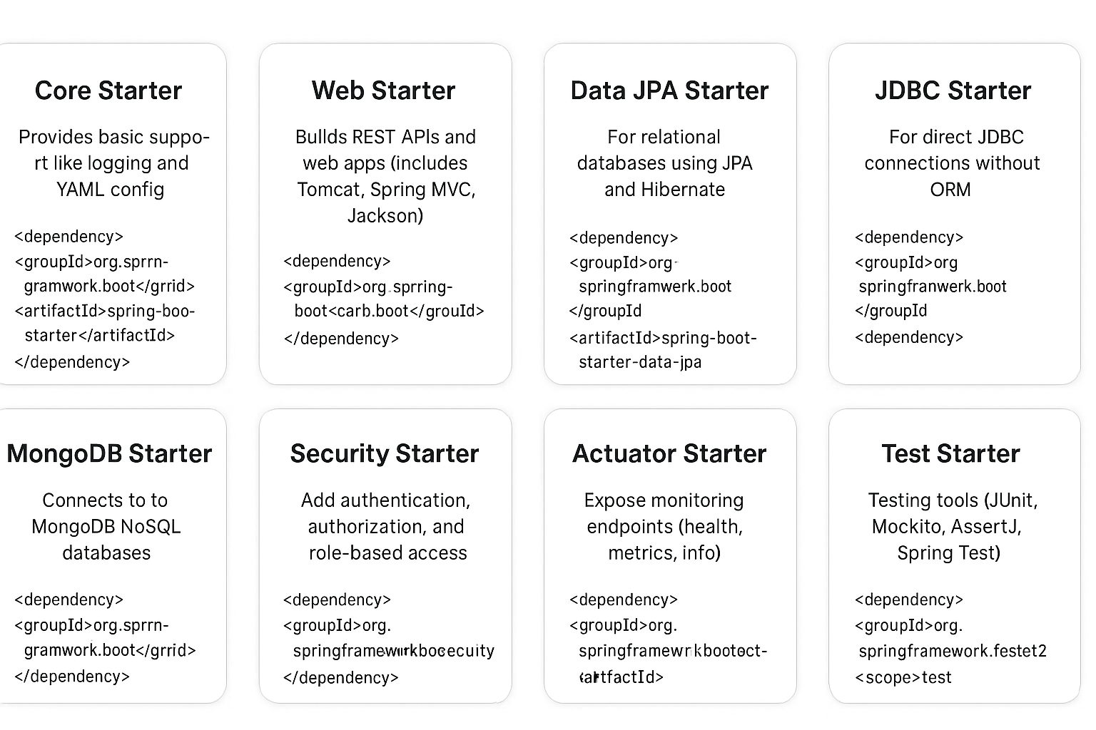
Types of Starters
Core Starter: Essential Spring Boot features, logging, YAML config.
Web Starter: REST APIs and web apps (MVC, Tomcat, Jackson).
Data JPA Starter: JPA/Hibernate ORM for relational databases.
JDBC Starter: Direct JDBC connection, no ORM.
MongoDB Starter: NoSQL data access via MongoDB.
Security Starter: Authentication and role-based authorization.
Actuator Starter: Production monitoring (health, metrics, info).
Test Starter: Bundled test tools (JUnit, Mockito, AssertJ).

Slide 21
Web & MVC Starters
Starter | Purpose
spring-boot-starter-web | Build REST APIs & MVC apps (Tomcat + Spring MVC + Jackson)
spring-boot-starter-thymeleaf | Server-side HTML rendering with Thymeleaf
spring-boot-starter-validation | Bean Validation support (JSR-380 / Hibernate Validator)

Slide 22
Data & Security Starters
Starter | Purpose
spring-boot-starter-data-jpa | Database access using JPA & Hibernate
spring-boot-starter-security | Authentication & authorization
spring-boot-starter-cache | Caching support for apps

Slide 23
Testing & Utility Starters
Starter | Purpose
spring-boot-starter-test | Unit & integration testing (JUnit, Mockito, Spring Test)
spring-boot-starter-actuator | Monitoring & management endpoints (health, metrics)
spring-boot-starter-mail | Email sending support

Slide 24
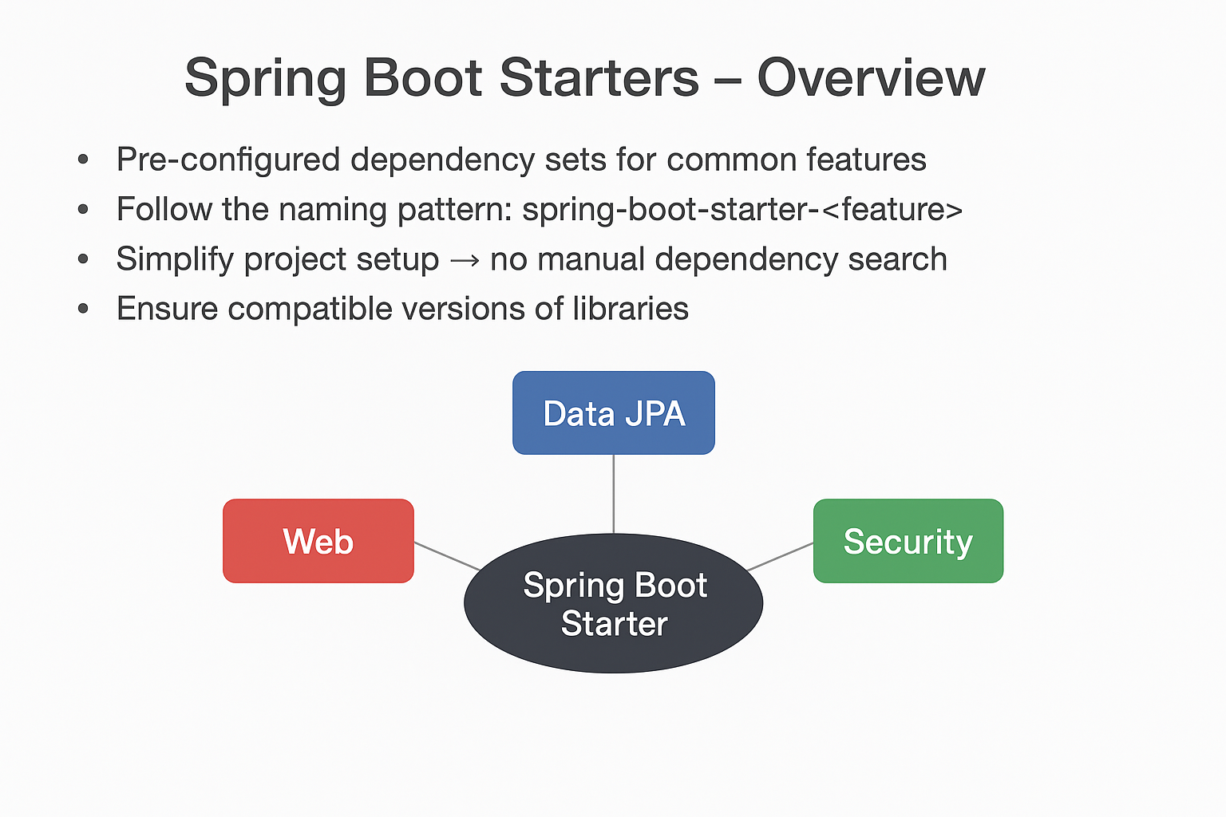

Slide 25
Application Properties / YAML in Spring Boot
Defination
In Spring Boot, Application Properties (application.properties) and YAML (application.yml) files are external configuration files used to define application settings such as server ports, database connections, logging levels, and custom properties. They allow developers to centralize configuration, manage environment-specific settings, and avoid hardcoding values in the application code.
Key Points:
application.properties → simple key-value pairs (key=value)
application.yml → hierarchical and human-readable format (key: value)
Both support Spring Profiles for environment-specific configurations.

Slide 26
Difference Between Properties and YAML
Feature / Aspect | application.properties | application.yml
Format | Key-Value (key=value) | Hierarchical, structured (key: value)
Readability | Simple for small apps | Better for complex/nested configurations
Ease of Use | Easy for beginners | Slightly steeper learning curve
Nested Configurations | Requires dot notation (spring.datasource.url) | Natural nesting using indentation
Environment Profiles | Supported via application-{profile}.properties | Supported via application-{profile}.yml

Slide 27
Pros & Cons of application.properties
Pros:
Lightweight and simple to use
Easy for beginners and small applications
Widely used and supported in Spring Boot
Works well for flat/simple configuration
Cons:
Difficult to manage deeply nested or hierarchical configurations
Can become cluttered for large projects
Less readable for multi-level configurations

Slide 28
Pros & Cons of application.yml
Pros:
Supports hierarchical, nested configurations naturally
More readable for complex or multi-level settings
Good for managing multiple environment profiles
Easier to maintain in large projects
Cons:
Indentation-sensitive; errors can break configuration
Slightly steeper learning curve for beginners
Can be verbose for very simple settings

Slide 29
Actuator
Provides production-ready features for monitoring and managing Spring Boot apps.
Exposes endpoints that provide insights into application health, metrics, and environment.
Helps in debugging, monitoring, and operational management without writing custom code.

Slide 30
Actuator Endpoints
Endpoint | Description
/actuator/health | Shows application health (UP/DOWN)
/actuator/metrics | Provides JVM and app metrics like memory, CPU, HTTP requests
/actuator/env | Displays environment properties and config values
/actuator/info | Custom application information (version, description)
/actuator/loggers | View and configure logging levels at runtime
/actuator/beans | Lists all Spring Beans loaded in the application context

Slide 31
Benifits
Monitor application health in real-time.
Track metrics for JVM, memory, CPU, HTTP requests.
Quick debugging without extra code.
Secure sensitive endpoints using Spring Security.
Supports custom endpoints for application-specific insights.

Slide 32
What is Spring CLI
A Command Line Interface for Spring Boot
Helps you quickly create and run Spring Boot projects
Supports both Groovy scripts (fast prototyping) and Maven/Gradle builds (real projects)
Provides shortcuts for:
Initializing projects
Running applications
Managing dependencies

Slide 33
Key Features of Spring CLI
Rapid prototyping:
Create Spring Boot apps without writing full Java classes or configuration.
Run apps directly:
Execute scripts with spring run command.
Auto-configuration support:
CLI handles Spring Boot setup automatically.
Dependency management:
Use @Grab to include dependencies quickly.

Slide 34
Advantages of Spring Boot CLI
Rapid Prototyping
Quickly create and run Spring Boot apps without writing full Java boilerplate.
Minimal Setup
No need for a full IDE; scripts can run directly from the command line.
Groovy Support
Can write concise applications in Groovy.
Auto-Configuration
Handles Spring Boot auto-configuration automatically.
Dependency Management
Easy inclusion of dependencies using @Grab.
Great for Learning & Demos
Excellent tool for experimenting with Spring features.

Slide 35
Disadvantages of Spring Boot CLI
Limited for Large Projects
Not ideal for complex enterprise apps; mostly for prototypes or small apps.
Groovy Dependency
While Groovy is optional, most CLI examples use it, which may be unfamiliar to some developers.
Debugging
Harder to debug compared to full IDE-based Java projects.
IDE Features Limited
No advanced IDE support for refactoring, auto-completion, or integration.
Not for Production-Ready Apps
Primarily a learning and rapid prototyping tool, not meant for large-scale production.

Slide 36
Commands of CLI
Command | What it Does
spring --version | Check installed Spring Boot CLI version
spring help | Show available CLI commands and usage
spring init --dependencies=web myapp | Create a new Spring Boot project with Web starter
spring init --dependencies=web,data-jpa,mysql --build=maven myapp | Generate a Maven project with Web + JPA + MySQL
mvn spring-boot:run | Run the Spring Boot app directly from source
mvn clean package | Build the project and package it into a JAR/WAR
java -jar target/myapp-0.0.1-SNAPSHOT.jar | Run the packaged JAR application
spring run app.groovy | (Optional) Run Groovy scripts with Spring Boot CLI
spring jar myapp.jar app.groovy | (Optional) Package a Groovy script into an executable JAR

Slide 37
Spring Boot Key Features Summary
Feature | Description
1. Auto-Configuration | Automatically configures Spring beans based on dependencies in the classpath, reducing boilerplate code.
2. Spring Boot Starters | Predefined dependency sets (like spring-boot-starter-web) to quickly add features without manually managing multiple libraries.
3. Application Properties / YAML | Centralized configuration for the application using application.properties or application.yml, supporting profiles, custom settings, and overrides.
4. Actuator | Provides built-in endpoints to monitor and manage your application, like health, metrics, and environment info.
5. Spring Boot CLI | Command-line tool to quickly create, run, and test Spring Boot applications, ideal for prototyping and demos.
6. Annotations | Core Spring Boot annotations (@SpringBootApplication, @RestController, @Service, etc.) simplify configuration, component scanning, and dependency injection.

